Slide 1

BOOST::BEAST
REST API
USING IN C++

Slide 2

Common part
Something about
FOR WHAT
ASIO
BEAST
Linking BEAST WITH ASIO REST HTTP Protocols CONCLUSION
REFERENCES

Slide 3

Something about
What you need to know to understand boost::beast :
Layered Network Model (ISO/OSI)
ASIO
Network Protocols

Slide 4
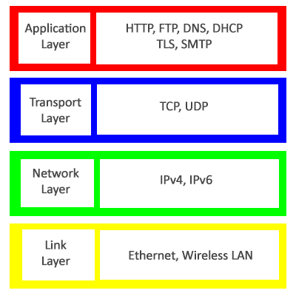
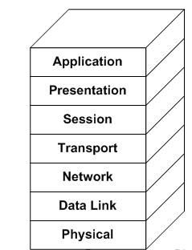
Layered Network Model (ISO/OSI)
The Internet Protocol Stack Model

Slide 5

FOR WHAT?

Slide 6

JG REBOOT

Slide 7

ASIO
Asynchronous programming model: Boost.Asio provides an asynchronous programming model that allows you to create efficient and scalable applications capable of handling a large number of connections simultaneously. Asynchrony avoids thread blocking and improves application performance.
Multi-threading support: Boost.Asio supports multi-threading of I/O events, which allows it to handle a large number of connections simultaneously. This is achieved by creating a pool of threads each of which can handle several connections.
Support of various protocols: Boost.Asio supports many network protocols such as TCP, UDP, SSL, etc. This allows developers to build applications running on the network. This allows developers to create applications working with different protocols using a single library.
Cross-platform: Boost.Asio is a cross-platform library that can be used on most operating systems including Windows, Linux and macOS.

Slide 8

ASIO
Ease of use: Boost.Asio provides a simple and intuitive application programming interface (API) for handling sockets and other network protocols. This makes the library accessible to novice developers.
Wide user community: Boost.Asio is part of the Boost library, which has a wide community of users and developers. This means that you can get support and help from other developers as well as find a lot of useful materials and examples of how to use the library online.

Slide 9

BEAST
Ease of use: Boost.Beast provides a convenient and intuitive application programming interface (API) for handling HTTP and WebSocket protocols. This makes the library accessible to novice developers. Also have supported HTTPS protocol, thanks to ASIO.
High performance: Beast is built on top of Boost.Asio and uses it to provide asynchronous I/O processing which gives you high performance and efficiency with network protocols.
Multithreading support: Beast takes advantage of Boost.Asio's capabilities to handle network protocols, allowing it to achieve high performance and efficiency. Boost.Asio provides multi-threaded I/O events and also supports asynchronous I/O, allowing Beast to scale and handle a large number of connections simultaneously.

Slide 10

BEAST
Multi-protocol support: Beast supports both HTTP and WebSocket, allowing developers to create applications that work with these protocols in a single library.
Cross-platform: Beast is part of the Boost library which is cross-platform and can be used on most operating systems, including Windows, Linux and macOS.
Extensibility: Beast provides the ability to extend the functionality of the library by creating custom handlers to handle I/O events.

Slide 11

Linking BEAST WITH ASIO
Beast at its core uses Asio to implement the asynchronous I/O needed to handle HTTP and WebSocket protocols. Asio provides mechanisms for asynchronous data reading and writing as well as for managing network connections.
Thanks to asio, it is possible to use SSL to make a secure HTTPS request.
Thus, Beast and Asio are closely related: Beast uses Asio to implement asynchronous I/O, and Asio provides the necessary functions and classes to handle asynchronous I/O in Beast. Using Asio allows Beast to provide high performance and efficiency with HTTP and WebSocket protocols.

Slide 12

Listener

Slide 13

Session

Slide 14

REST API
REST API (Representational State Transfer Application Programming Interface) is an architectural style used to create web services that exchange data with clients over HTTP.
The REST API is used to exchange data between client and server applications using the HTTP protocol.
The REST API relies on the use of standard HTTP methods such as GET, POST, PUT and DELETE to perform operations on resources.
In the REST API, each resource is represented by a unique URL, and client applications can send requests to that address to access the resource.
The REST API uses data formats, such as JSON or XML, to represent resources and transfer data between the client and the server.
The REST API is used in many applications, such as social networks, messengers, online stores, and others, and allows you to create flexible and scalable web services that can exchange data with client applications on different platforms and devices.

Slide 15
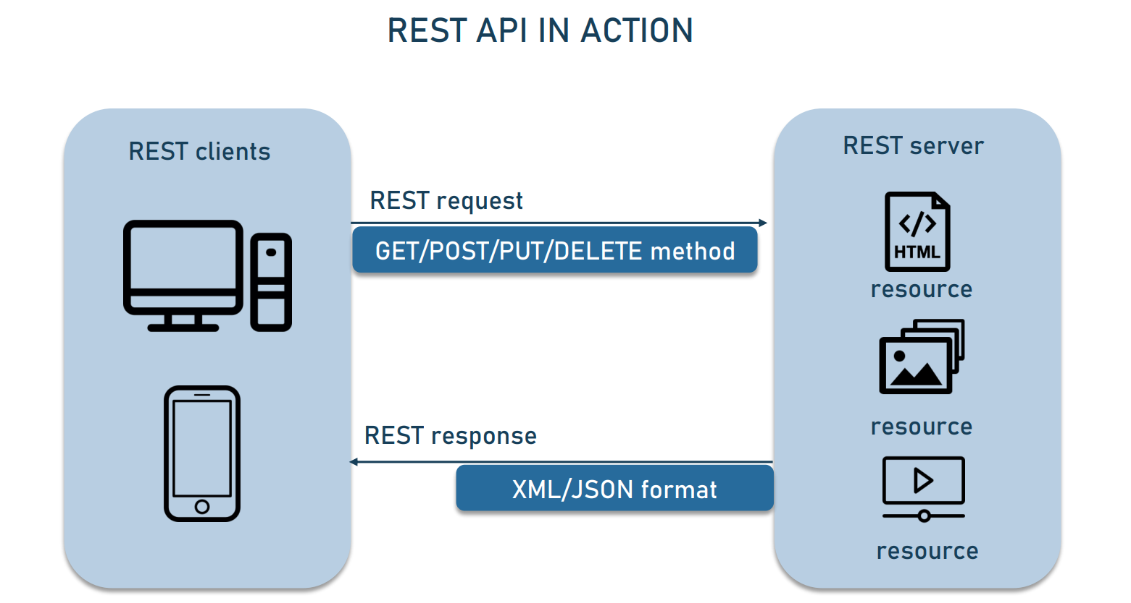
REST API

Slide 16
HTTP PROTOCOLS
(HyperText Transfer Protocol)
Is an application layer protocol used to
transfer data between a client and a server on the Internet.
There are several versions of the HTTP protocol:
HTTP/0.9 - the first version of the protocol,
which was created in 1991 and allowed only to receive documents in HTML format.
HTTP/1.0 is a more advanced version that was released in 1996.
It added support for request and response headers,
the ability to transfer files and the use of different request methods.
HTTP/1.1 is the current version of the protocol,
which was released in 1999. It includes improved support for caching,
connection management, and support for additional request methods
such as OPTIONS, PUT, and DELETE.
HTTP/2 is a new version of the protocol released in 2015.
It added support for multiple streams in a single connection,
binary message format, and header compression, which improves
performance and reduces the load on the server.
HTTP/3 is the newest version of the protocol, released in 2020.
It uses the QUIC protocol as the transport,
which reduces data latency and improves performance on low-speed connections.

Slide 17
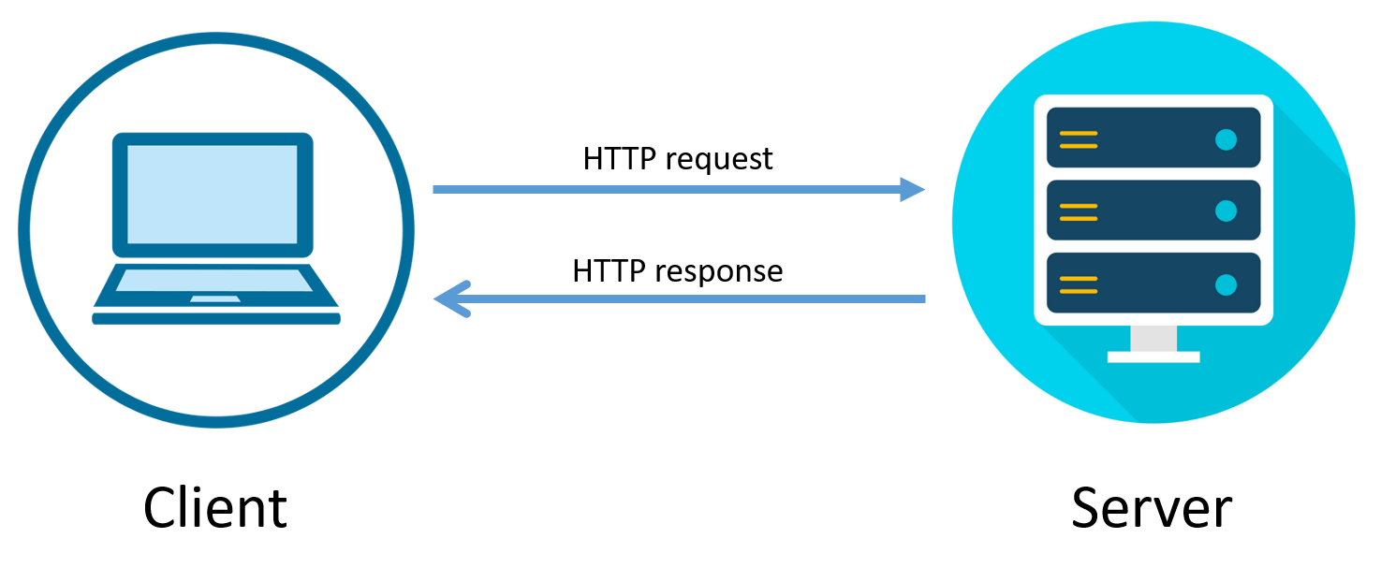
HTTP PROTOCOLS
Beast supports the following versions of the HTTP protocol:
HTTP/1.0
HTTP/1.1
HTTP/2

Slide 18

CONCLUSION

Slide 19




REFERENCES

